Slide 1
Early Detection of DDoS in SDN using Entropy
By: Vaibhav Sahu (21812022)
Under supervision of:
Dr. Anoop Kumar Patel, Asst. Prof.

Slide 2
Index
DoS and DDoS
Introduction
Traditional Network vs SDN
Literature Review
Early Detection Using Entropy
Proposed Approach and Data Flow Diagram
Software / Tools Used
Experiment Walkthrough
Results
Conclusion
Skills Learnt
References

Slide 3
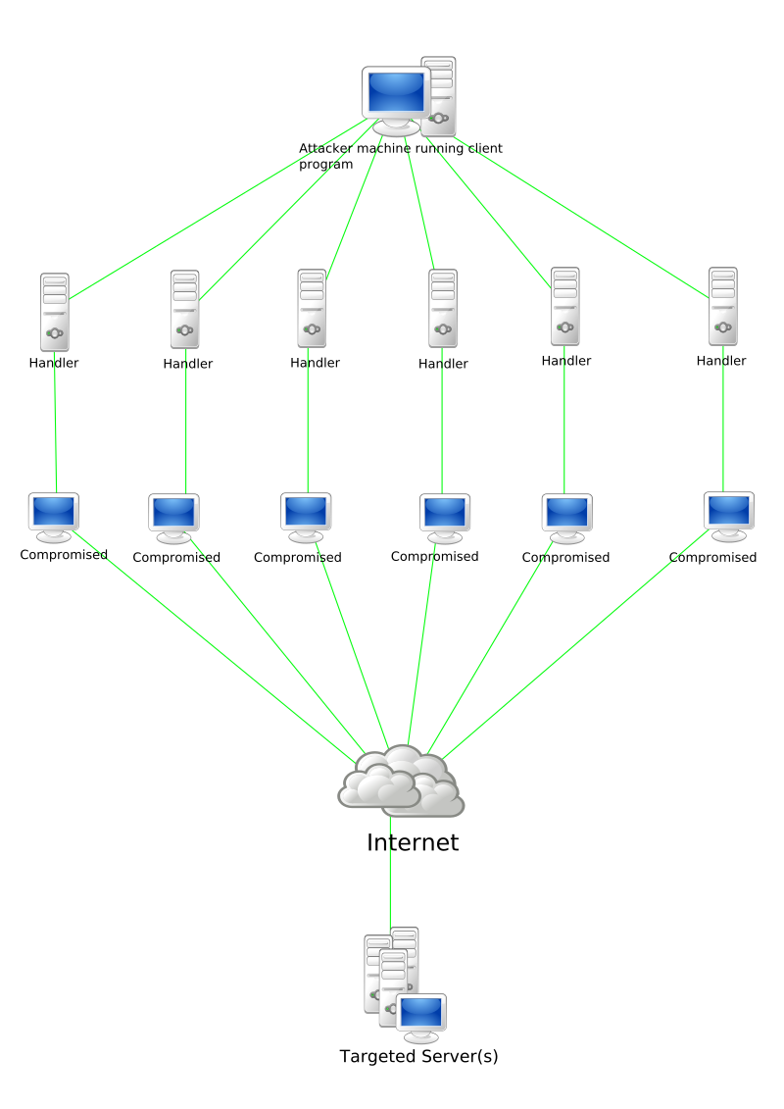
DoS and DDoS
DoS stands for Denial of Services
DDoS stands for Distributed Denial of Services
It is a cyber attack
Preventing legitimate requests from being fulfilled.
Whereas, in DDoS, incoming traffic flooding the victim originates from many different sources.
In simpler words, DoS or DDoS attack is analogous to a group of people crowding the entry door of a shop, making it hard for legitimate customers to enter, thus disrupting trade.

Slide 4

Introduction
Software Defined Networking (SDN) is a new networking approach that is introduced with the goal to simplify the network management by separating the data and control planes.

Slide 5
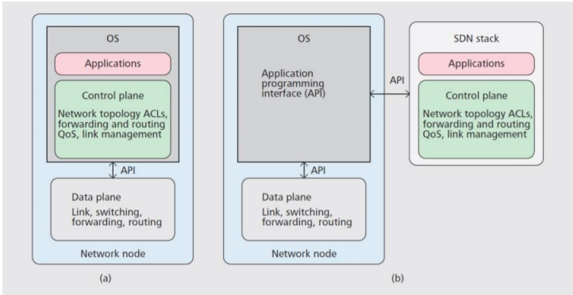
SDN vs Traditional Network

Slide 6
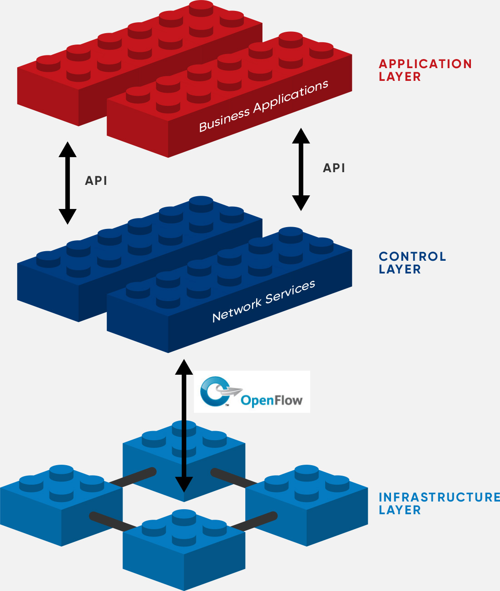
Introduction contd.
The centralized structure of the controller could lead on to several security challenges. One of such critical challenges is that the impact of distributed denial of service attacks (DDoS) on SDN networks.
It is vital to form sure an efficient and trustable detection method is in situ to detect such attacks and appropriate action is taken followed by an early detection.
So in this presentation we will talk about proposed detection using entropy and how its helpful to detect attack in early stages

Slide 7
Literature Review
Mousavi et al. proposed an entropy-based technique for early detection of
malicious traffic targeting to the POX controller. The limitation of this work is that,
when the number of hosts increases the false positive report increases.[1]
A packet in filtering technique has proposed by Kotani et al. to protect the
controller. This technique lists the contents of the packet header fields before the
forwarding the packet_in event. On the contrary, if the attacker generates new
flows in which the packets have a distinct value from the listed one the technique
will be inefficient[2].
Braga et al. propose a DDoS detection method built into NOX controller based on
Self-Organizing Maps (SOM). SOM is an unsupervised artificial neural network
trained with the features of the network flow that's periodically collected from the
switches. The traffic is classified as either normal or abnormal based on the SOM
Pattern[3].
YuHunag et al. Chungwa Telecom Co. proposes an OpenFlow DDoS Defender that
monitors flows on an OpenFlow switch[4]

Slide 8
Early Detection of DDoS using Entropy
Why Entropy??
Due to the limited resources of the controller, an early detection should be within the first few hundred packets of the attack
Entropy has an ability to find the randomness that’s why we used it for our detection. The higher the randomness the higher is the entropy and vice versa

Slide 9
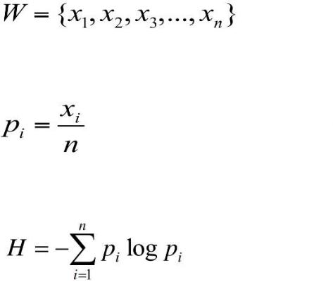
Why Entropy Contd.
Let W be a set of data with n elements and x is an event in the set. Then, the probability of X happening in W. To measure the entropy, referred to as H, we calculate the probability of all elements in the set and sum

Slide 10
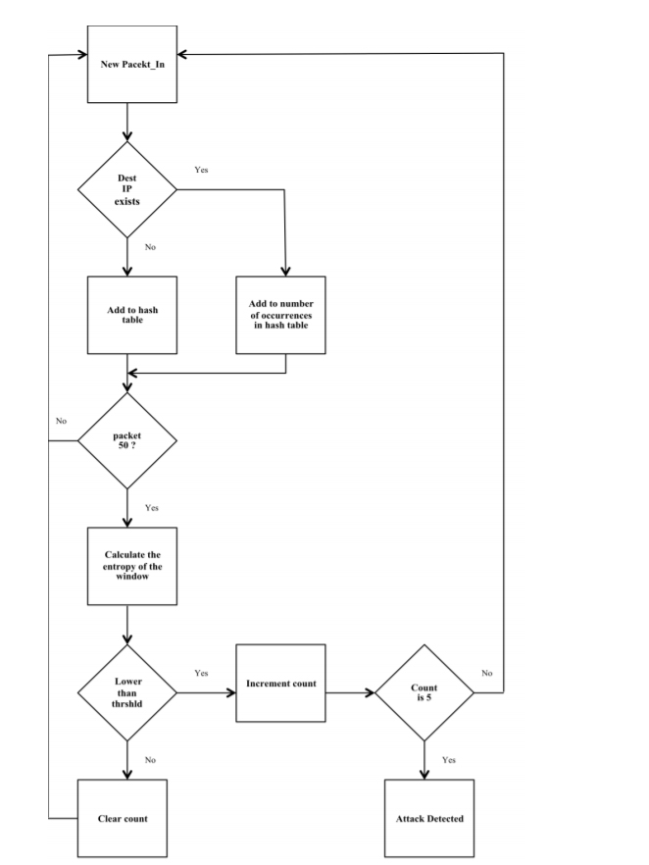
Proposed Approach
Entropy has an ability to find the randomness that’s why we used it for our detection. The higher the randomness the higher is the entropy and vice versa.
Using entropy, it is possible to ascertain its value drop when an outsized number of packets are attacking one host.
We calculate entropy for every window size 50 and checks its against threshold entropy.
If for 5 consecutive times its less than threshold entropy and decreasing continuously. We consider it as attack.

Slide 11

Contd.
Two conditions are chosen to be the trigger for an attack in our method. One is the threshold and the other is the continuity of the attack
An attack happened if entropy of attack HA, is smaller than the threshold and, having five consecutive lower than threshold entropies is true. Otherwise, there is no attack
Where : T is Threshold Entropy
S is an array if 5 windows with lower than T entropy

Slide 12
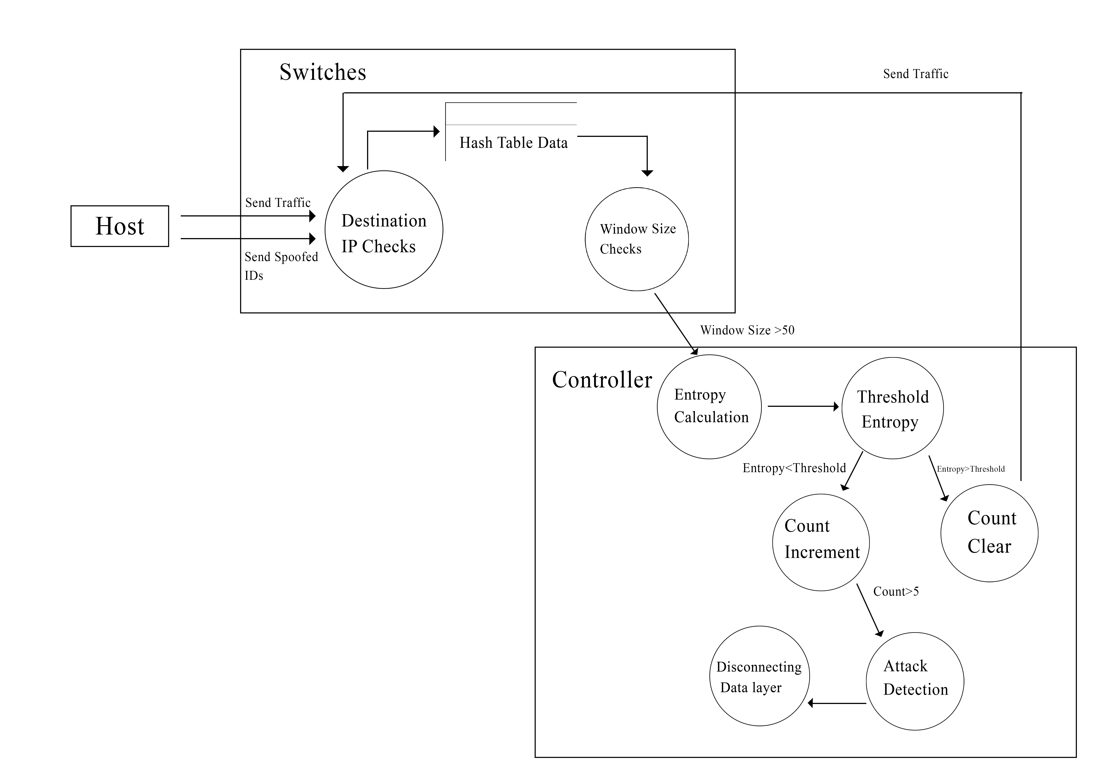
Data flow Diagram of Proposed Work

Slide 13
Software and tools used
01
02
03
POX Controller
Pox is widely used for experiments, it's fast, lightweight and designed as a platform so a custom controller is often built on top of it.
Mininet
Mininet is the network emulator that is used for this experiment. It is the quality network emulation tool which will be used for SDN
Scapy
Scapy is used for Packet Generation. Scapy is a powerful tool for packet generating, scanning, sniffing, attacking and packet forging.

Slide 14
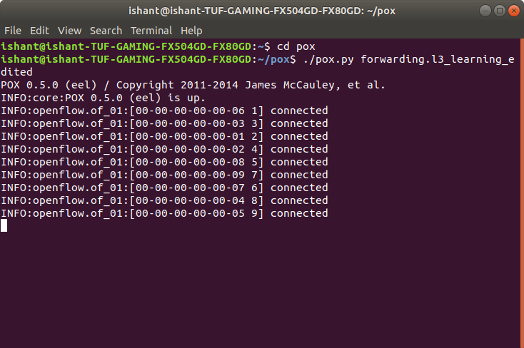
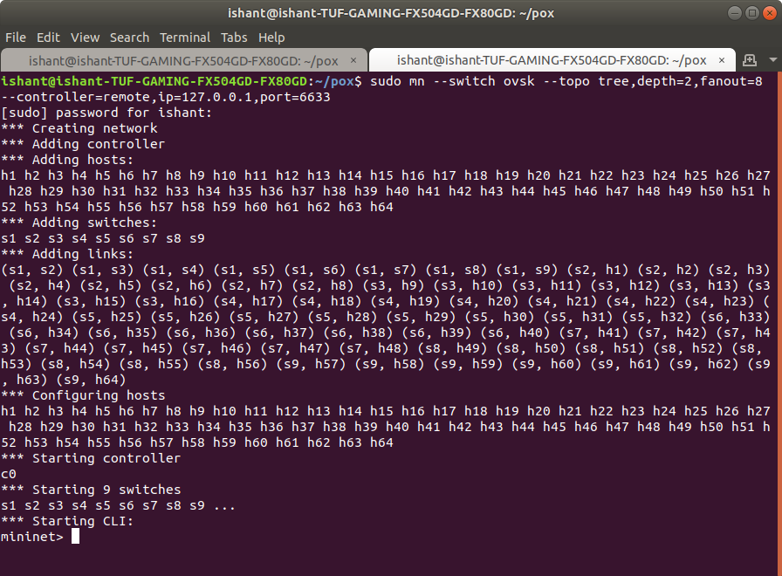
Experiment Walkthrough
First, we copy our detection.py in pox/pox/forwarding where we edited l3_forwarding to capture packets and detect entropy.
2. Make a copy of the attack.py and traffic.py into accessible location in your mininet/custom folder.
3. We open terminal and activate our pox controller.
4. In another terminal tab we create an mininet topology using:
sudo mn –switch ask –top tree, depth=2, fanout=8 –controller=remote, ip=127.0.0.1, port=6633
5. Open the Xterm of host h1 and launch the normal traffic in the mininet network. Let it run for few minutes to generate entropy values.
$python traffic.py -s X -e Y

Slide 15
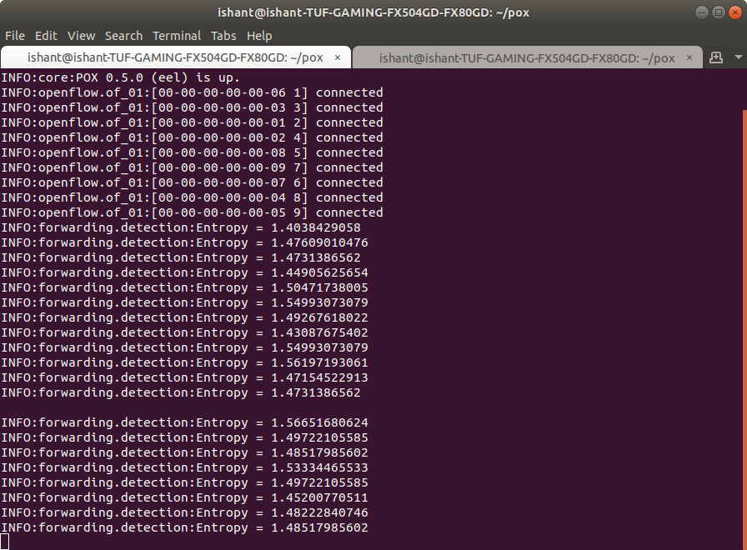
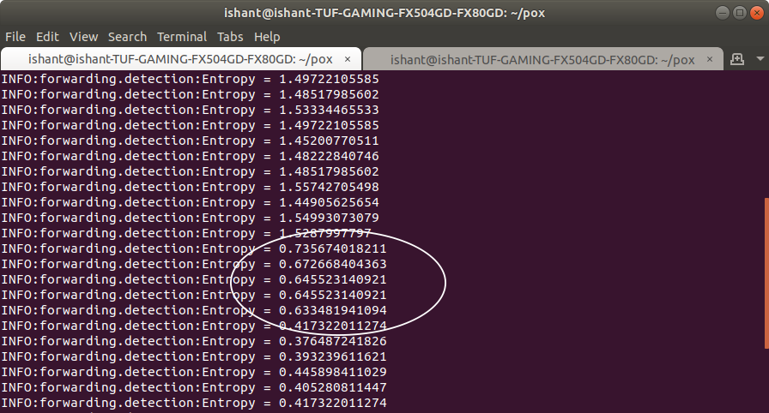
6. We observe Entropy Values in POX terminal Tab.
7. Now we attack using Xterm of h2 and h3 to observe Entropy Value.
$python attack.py 10.0.0.Z
8. As we attack, we saw a drop in entropy value which helps us to detect DDos Attack.

Slide 16
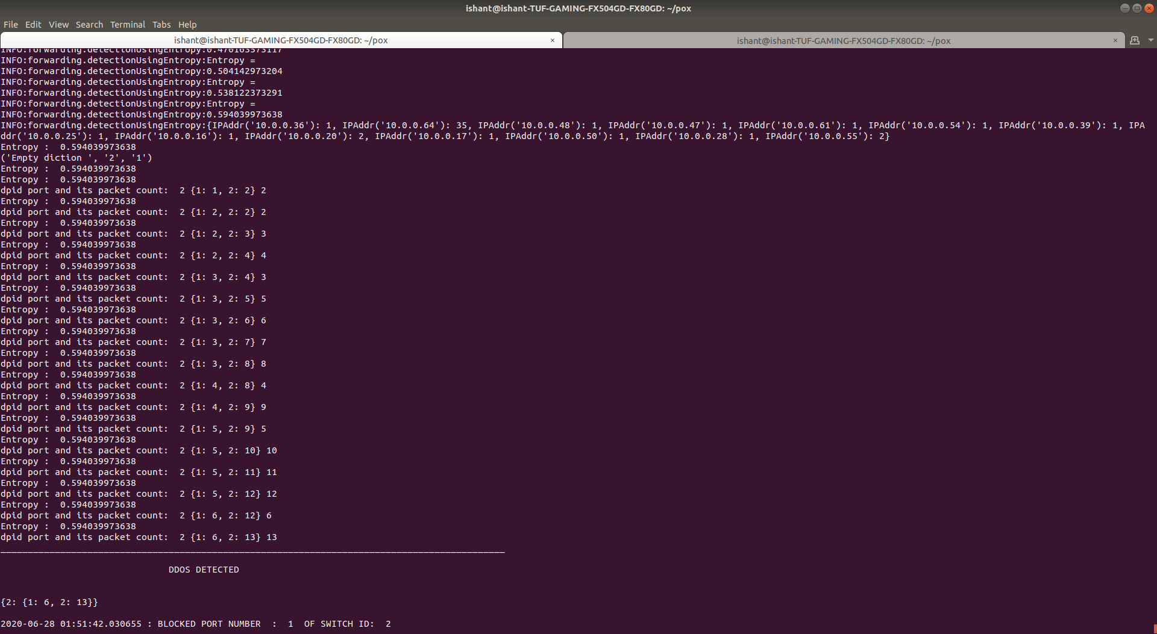
Results

Slide 17
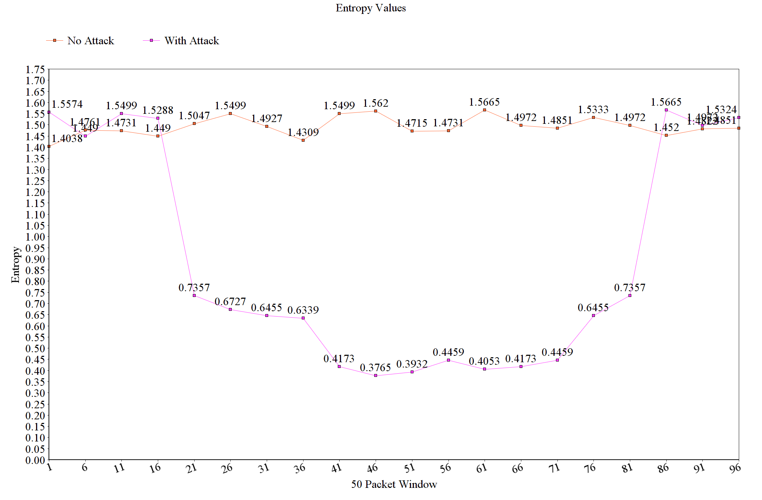
Results

Slide 18

Conclusion
As a result of the experiment, Entropy DDoS detection turns out to be a effective solution for the detection of anomaly in network traffic in a SDN architecture. This can be a efficient method to adopt at software defined data centers.
The contributions of this research are:
Showed how DDoS attack can overwhelm the controller in SDN architecture.
Proposed a lightweight and fast DDoS detection mechanism based on entropy, to protect the controller.
Implement the proposed mechanism using Mininet and POX controller.
Showed the effectiveness of the solution through extensive simulations

Slide 19

Skills Learnt
Different approaches for DDoS detection and its Mitigation
Topologies and how to create
Using Mininet for creating virtual network
POX Controller
Scapy
Python ( Networking )

Slide 20
References
Dallou, Jawad & Al-Duwairi, Basheer & Al-Jarrah, Mohammad. (2020). ADAPTIVE ENTROPY-BASED DETECTION AND MITIGATION OF DDOS ATTACKS IN SOFTWARE DEFINED NETWORKS. International Journal of Computing. 399-410. 10.47839/ijc.19.3.1889.
Kotani, Daisuke & Okabe, Yasuo. (2016). A Packet-In Message Filtering Mechanism for Protection of Control Plane in OpenFlow Switches. IEICE Transactions on Information and Systems. E99D. 695-707. 10.1587/transinf.2015EDP7256.
Braga, Rodrigo & Mota, Edjard & Passito, Alexandre. (2010). Lightweight DDoS flooding attack detection using NOX/OpenFlow. Proceedings - Conference on Local Computer Networks, LCN. 408-415. 10.1109/LCN.2010.5735752.
Qiao Yan, F. Richard Yu, Senior Member, IEEE, Qingxiang Gong, and Jianqiang Li: Software-Defined Networking (SDN) and Distributed Denial of Service (DDoS) Attacks in Cloud Computing Environments: A Survey, Some Research Issues, and Challenges IEEE COMMUNICATIONS SURVEYS & TUTORIALS, VOL. 18, NO. 1, FIRST QUARTER 2016
Ijaz Ahmad, Suneth Namal, Mika Ylianttila, Senior Member, IEEE, and Andrei Gurtov, Senior Member, IEEE: Security in Software Defined Networks: A Survey IEEE COMMUNICATION SURVEYS & TUTORIALS, VOL. 17, NO. 4, FOURTH QUARTER 2015
Prashant Kumar, Meenakshi Tripathi, Member, IEEE, Ajay Nehra, Mauro Conti , Senior Member, IEEE, and Chhagan Lal: SAFETY: Early Detection and Mitigation of TCP SYN Flood Utilizing Entropy in SDN IEEE TRANSACTIONS ON NETWORK AND SERVICE MANAGEMENT, VOL. 15, NO. 4, DECEMBER 2018
Zhenpeng Liu1,2, Yupeng He1 , Wensheng Wang3 , Bin Zhang2,*: DDoS Attack Detection Scheme Based on Entropy and PSO-BP Neural Network in SDN
POX Controller: https://github.com/noxrepo/pox/
Mininet Install and commands: http://mininet.org/download/

Slide 21
THANKS
Any Questions

